Slide 1

ITNU-NIRMA UNIVERSITY,AHMEDABAD
Digital Logic Design
Faculties : Dr. MihirSir Shah
Presentation On
Touch Switch Using IC 4011
Presentation By :
Darshil Mavadiya-22BEC508
Krishana Pandya-22BEC511
Project

Slide 2
CONTents
CD 4011 WORKING
COMPONENTS
CIRCUIT Diagram
PIN CONFIGURATION
BREADBOAD CIRCUIT DIAGRAM
WORKING VIDEO

Slide 3
CD 4011 WORKING
CD4011 IC is a quadrable two-input NAND gate IC that includes four NAND gates within a single chip. The logic used by this gate is CMOS where designing of all the inputs and outputs can be done based on the voltage level of CMOS logic.
This IC is used to perform NAND logic otherwise you can utilize a combination of 4 logic gates to achieve AND/OR operation also. CD4011 NAND gate ICs offer the system designer through direct execution of the NAND gate function & supplement the existing CMOS, gate family.

Slide 4
Components
IC CD 4011
RESISTORS 10 M
RESISTOR 100 Ohm
LED
Jumper Wire

Slide 5
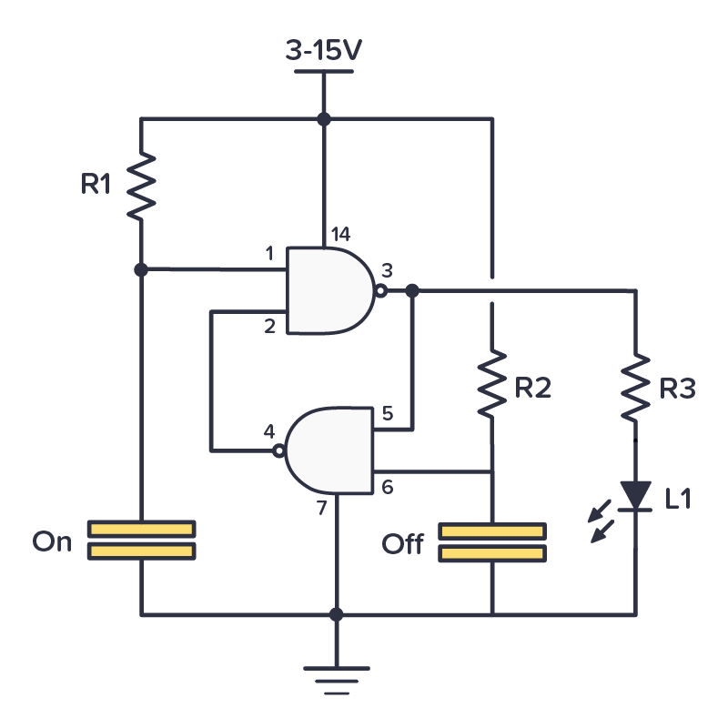
Circuit Diagram

Slide 6
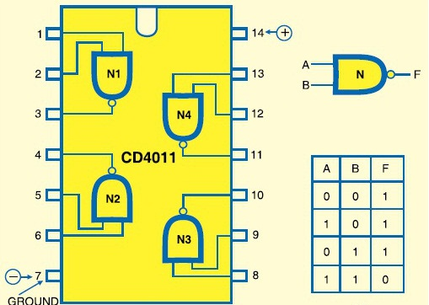
IC CD 4011

Slide 7
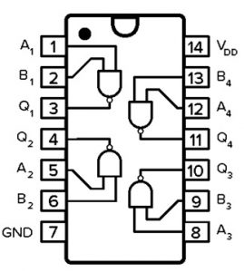
CD 4011 PIN CONFIGURATION
Pin1 (INPUT A): This pin is the input A of the 1st NAND gate
Pin2 (INPUT B): This pin is the input B of the 1st NAND gate
Pin3 (OUTPUT J): This is an o/p J pin of the 1st NAND gate
Pin4 (OUTPUT K): This is an o/p K pin of the second NAND gate
Pin5 (INPUT C): This is the Input C pin of the second NAND gate
Pin6 (INPUT D): This is the Input D pin of the second NAND gate
Pin7 (GND): This is GND pin

Slide 8
CD 4011 PIN CONFIGURATION
Pin8 (INPUT E): This is an Input E pin of the third NAND gate
Pin9 (INPUT F): This is an Input F pin of the third NAND gate
Pin10 (OUTPUT L): This pin is an Output L pin of the third NAND gate
Pin11 (OUTPUT M): This is an Output pin M of the fourth NAND gate
Pin12 (INPUT G): This is an Input pin G of the fourth NAND gate
Pin13 (INPUT H): This is an Input H pin of the fourth NAND gate
Pin14 (VCC/VDD): This pin connects with a 5V power supply

Slide 9
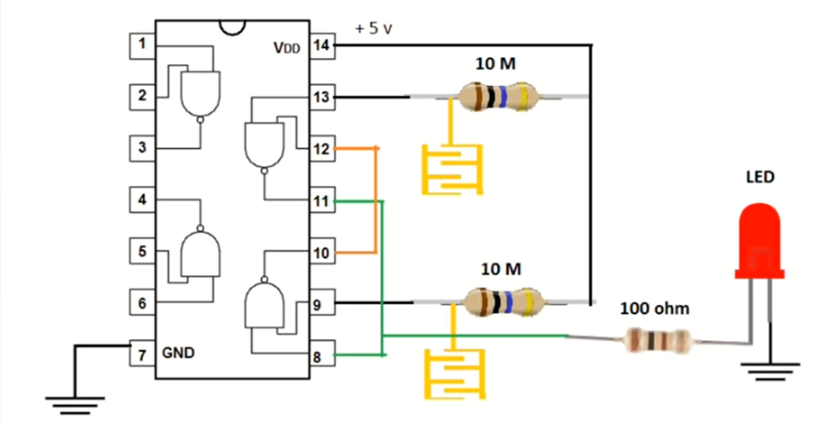
Circuit Diagram

Slide 10

WORKING VIDEO

Slide 11
Thank You

